Slide 1
Samsung Innovation Campus

Slide 2
GST Calculator
Team Name :- Code fellas
Team Members :- Anima Bhalla
Mudit Chandwani
Sampoorn Pande
Hemant Mishra
Anupam Singh

Slide 3
GST Calculator
UNIT 1. Introduction to GST
1.1. What is GST?
1.2. How GST works?
1.3. Objective of GST
UNIT 2. Introduction to GST Calculator
2.1. What is GST calculator?
2.2.How to Calculate GST?
UNIT 3. Project Overview
3.1. Languages Used
3.2. Working
Notes:
Note:

Slide 4
1.1 What is GST?
1.
Introduction to GST
01
GST(Goods and Services) is a value-added tax levied on the supply of goods and services. It is an important component of modern financial transactions. Understanding GST calculation is crucial for businesses to comply with tax regulations and optimize their financial operations.
1.2 How GST works?
GST is a single tax on the supply of goods and services. That means the end consumer will only bear the GST charged by the last dealer in the supply chain. For example,
The manufacturer will have to pay GST on the raw material that is purchased and the value that has been added to make the product.
The service provider will be responsible for paying GST on both the product's purchase price and the value added to it.
It must be paid by the retailer on both the product they bought from the distributor and the margin they added.
GST must be paid on the product that has been purchased.

Slide 5
Objective Of GST
1.
Introduction to GST
01
To minimize the cost
To enhance the productivity and efficiency
To make taxation simple by eliminating multiple tax systems
Enhances the compliance with businesses
To improve the country’s revenue
To make "One Nation, One Tax"
To replace the majority of indirect taxes
To widen the taxpayer base in India
To decrease the cascading effect of taxes

Slide 6
2.1 What is GST calculator?
2
Introduction to GST calculator
02
A GST calculator is an online tool that you can use to figure out how much GST you owe for a given month or quarter, based on the products. Simply follow these 2 steps: Type in the net price of your service or product and the GST tax slabs that apply, such as 5%, 12%, 18%, or 28%.
2.2 How to calculate GST?
GST Rates :- The GST Council has assigned GST rates to different goods and services. While some products can be purchased without any GST, there are others that come at 5% GST, 12% GST, 18% GST, and 28% GST. The GST Calculator makes it easy for taxpayers to determine how much GST must be paid.
Here is an example showing how you can calculate your GST liability:
Let us assume you need to calculate GST for a product that falls under the 5% GST slab and has a cost amount of ₹ 1,00,000. Then using the formula (Cost Amount x GST Rate Percentage) / 100, we get 1,00,000 x 0.05 = ₹ 5,000. By adding this to the original price, you get the net price which should be ₹ 1,05,000.

Slide 7
3.1 Languages Used
3
Project Overview
03
HTML
CSS
JavaScript

Slide 8
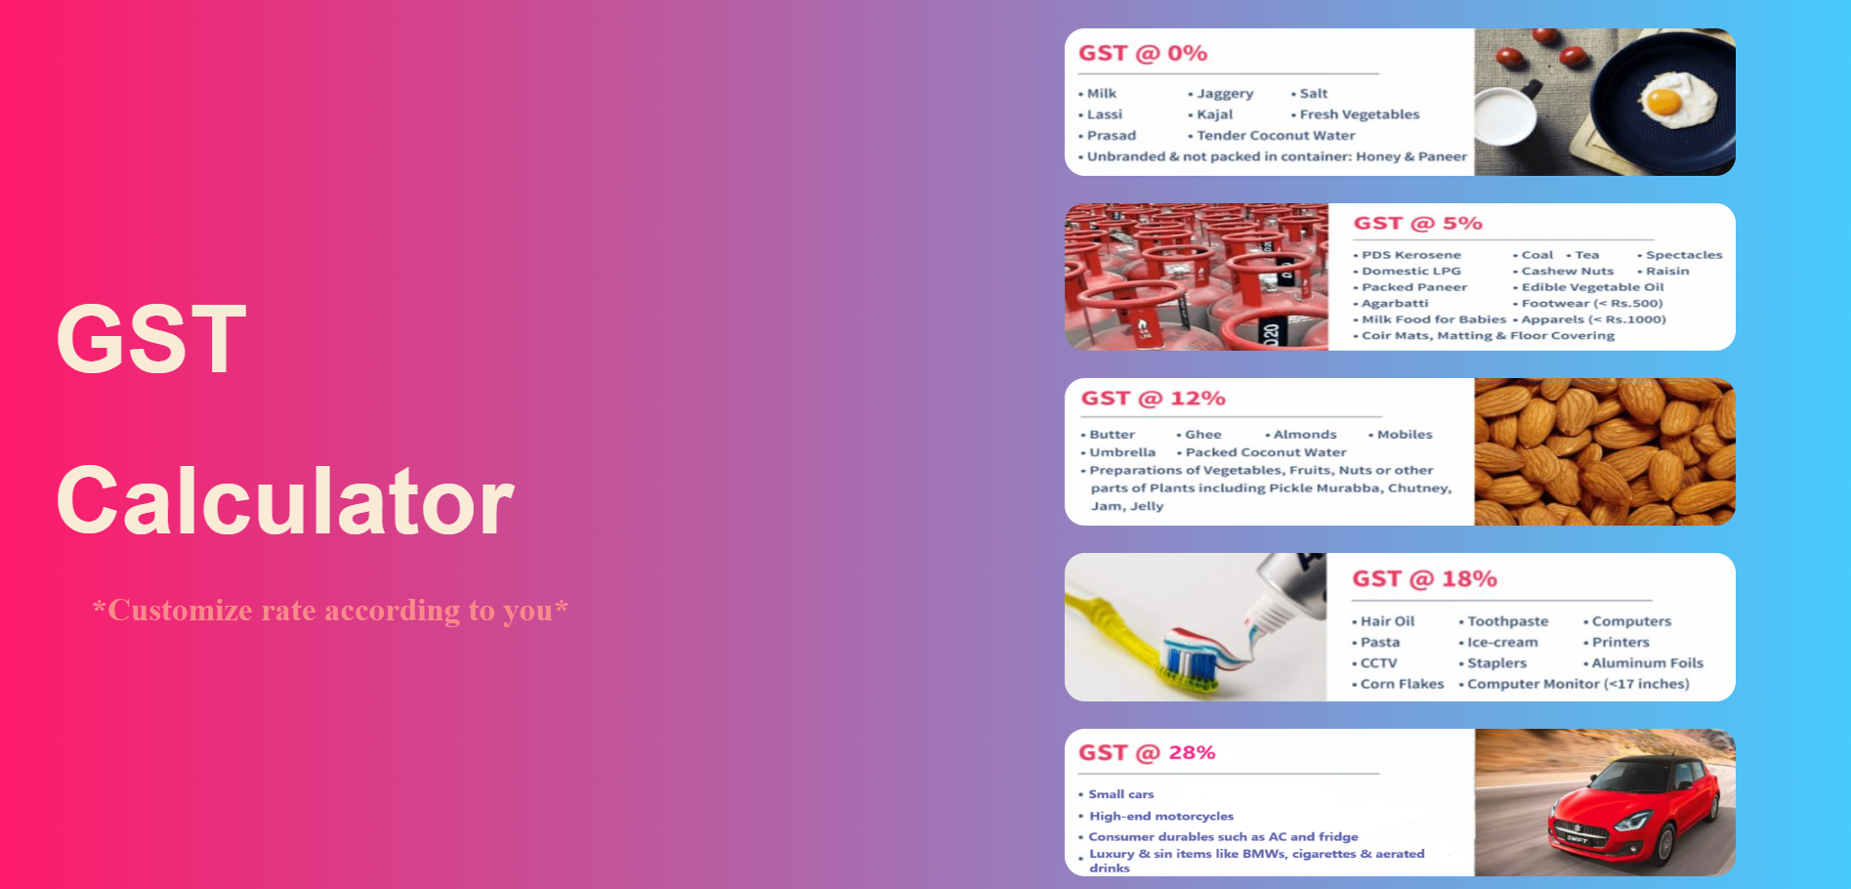
3.2 Working
3
Project Overview
Here we Categorized the products according to their GST rates

Slide 9
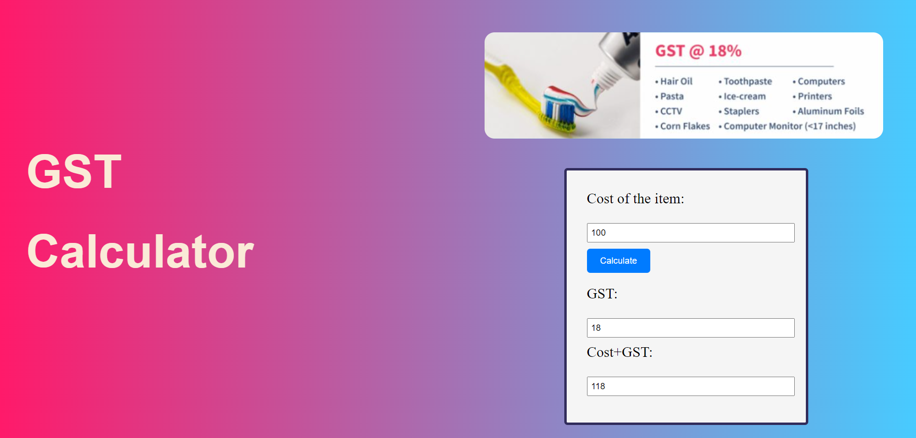
3.2 Working
3
Project Overview
03
One can select rate according to the product whose GST needs to be calculated and enter the cost of their item to calculate GST.

Slide 10
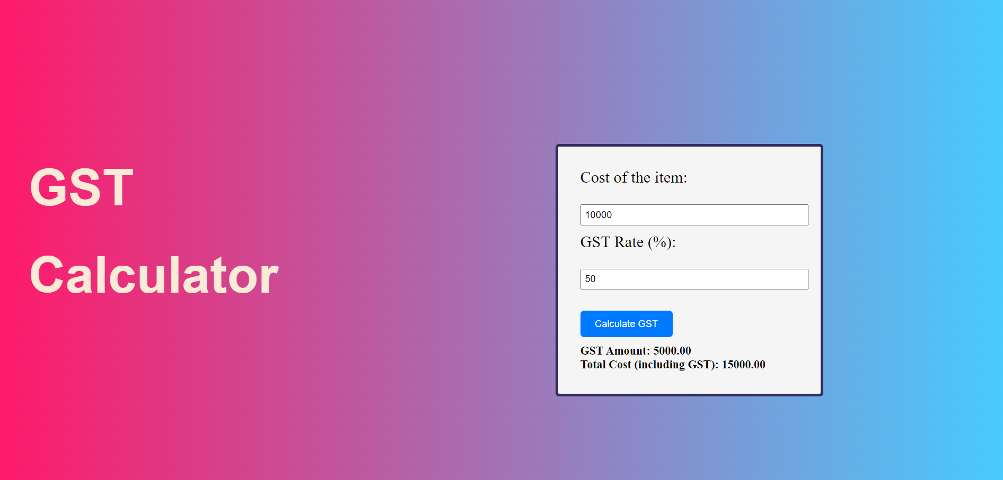
3.2 Working
3
Project Overview
03
Also you can set the GST Rate according to you to calculate GST and Total cost of the product.

